Slide 1
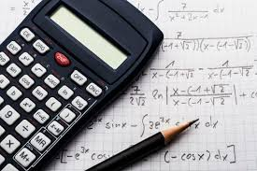
Design Technology
Exam board AQA
Exam is made up of two sections; Core technical and specialist area.
2 hour exam
Equipment needed: Pen, pencil, ruler, eraser, calculator.
15 % math’s questions

Slide 2
Revision checklist with key themes
Students will be given key themes and topics to revise for the exam.

Slide 3
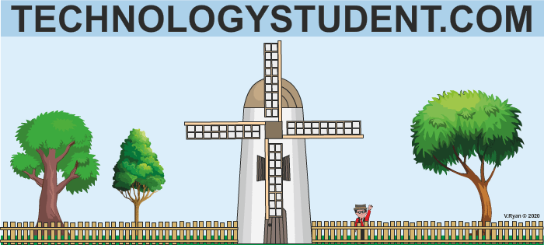
Excellent resources to aid revision
Websites: Play show to click on hyperlinks
Past papers

