Slide 1
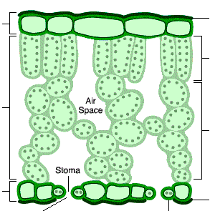
Describe aerobic respiration:
Summarise the reaction
Exo/Endothermic?
Where does it happen?
Describe anaerobic respiration:
Summarise the reaction
Why is lactic acid bad for us?
What is muscle fatigue?
How do we get rid of the lactic acid?
How does anaerobic respiration in yeast and plants differ from mammals?
Label each part of the structure of a leaf:
Describe the role of each part and explain how it is adapted for photosynthesis.
Comparing Photosynthesis and Respiration
Name | Photosynthesis | Respiration
Reactants
Products
Who does it?
When do they do it?
Where does it happen?
Topic 4 Bioenergetics
Describe the limiting factors for photosynthesis.
Temperature –
Light intensity –
Concentration of CO₂ –
Describe the different ways plants use glucose:
Cellulose –
Starch –
Proteins and nitrates –
Lipids –
Glucose –
What are mitochondria?
What are chloroplasts?
Describe the body’s response to exercise:
Muscles -
Glycogen -
Heart rate -
Breathing rate -
Describe the ways mammals use energy from respiration:
Building –
Muscles –
Temperature –
Discuss metabolism and the liver in:
It’s role –
Removing lactic acid –
List metabolic reaction examples –

