Slide 1
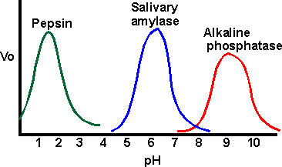
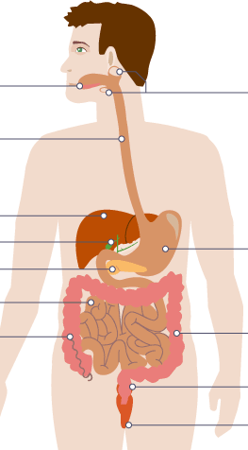
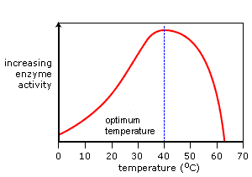
Define the following terms and give an example of each:
Cells –
Tissues –
Organs –
Organ system -
What is the role of:
Pancreas –
Liver –
Small intestine –
Large intestine –
Rectum –
Anus –
Describe how you would use:
Benedict’s reagent to test for sugar –
Iodine to test for starch –
Biuret solution to test for protein –
Draw a diagram here to show how enzymes work:
Where is bile produced:
Where is bile stored:
Describe the 2 jobs of bile:
1)
2)
Topic 2 Organisation
Label the digestive system
Digestive enzymes
Enzyme | What it breaks down | What it breaks down into | Where it is produced | Where it works
Amylase
Carbohydrase
Protease
Lipase
Using the graph
What is the optimum pH of:
Pepsin:
Salivary amylase:
Alkaline phosphatase:
Enzymes are made of ____________. These are made up of _________ _______. Enzymes are ______________ ___________. They ________ up reactions by lowering the _____________ ________. Enzymes have an _________ _______. This is where the substrate joins. The active site is _____________________ and ___________ to the corresponding substrate. Enzymes speed a reaction up but do not ________ it.
Words: Protein, specific, active site, change, complementary, biological catalysts, amino acids, activation energy, speed.
Explain this graph:
What is meant by the term ‘optimum temperature’?
Describe this graph:
What is the role of the small intestine?
How is the small intestine adapted for it’s role?
What is meant by the ‘lock and key theory’?

Slide 2
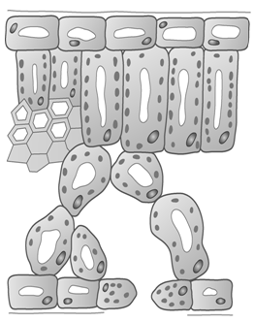
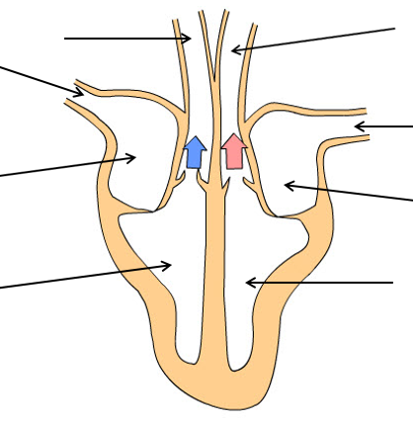
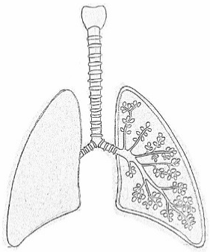
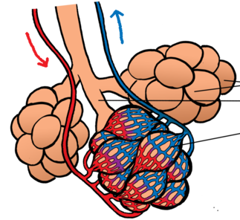
Label the left atrium, left ventricle, right atrium, right ventricle, aorta, vena cava, pulmonary artery and pulmonary vein on the diagram
What is the job of the heart?
Where does the left ventricle pump blood to?
Where does the right ventricle pump blood to?
What is the function of an artery?
How is an artery adapted for its function?
What is the function of a vein?
How is a vein adapted for its function?
What is the function of a capillary?
How is a capillary adapted fro its function?
Label the epidermis, spongy mesophyll, palisade mesophyll, xylem, phloem, guard cells and stomata.
What is the job of the pacemaker?
Why might someone have an artificial pacemaker fitted?
Label the trachea, bronchi and alveoli
Label the capillary network
What is transpiration?
What factors affect the rate of transpiration?
What is translocation?
What is coronary heart disease?
What is cancer?
What is the difference between a benign and a malignant tumour?
What is the function of the xylem?
What the function of the phloem?
In what ways can a heart valve become faulty?
How can a faulty heart valve be treated?
What is the function of:
Epidermis tissue –
Palisade mesophyll –
Spongy mesophyll –
Meristem tissue –
Name some risk factors for the following diseases:
Type 2 diabetes –
Cardiovascular disease –
Cancer –
Lung cancer/ lung disease –
What is a coronary artery and where would you find them?
How does smoking and alcohol consumption effect unborn babies?

