Slide 1
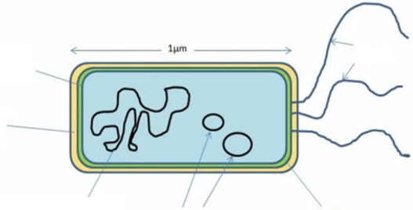
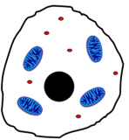
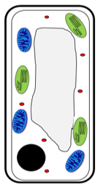
What is a eukaryotic cell?
What is a prokaryotic cell?
Label the bacterial cell
State what happens in the different stages of the cell cycle
Stage 1 –
Stage 2 –
Stage 3 -
Topic 1 Cell Biology
What is therapeutic cell cloning?
Label the animal cell
Describe the function of each of these organelles
Highlight the organelles only found in plants green
Nucleus
Cytoplasm
Cell membrane
Mitochondria
Ribosomes
Cell wall
Chloroplasts
Vacuole
What is the job of the flagellum?
What is a plasmid?
What is the job of the slime layer?
Define the following terms:
Chromosome –
Gene –
DNA –
Give one way in which each of the following cells is adapted to its job:
Nerve cell –
Muscle cell –
Sperm cell –
Root hair cell –
Xylem cell –
Phloem cell -
Label the plant cell
Why is mitosis important?
What is an embryonic stem cell?
What is an adult stem cell?
What is meristem tissue?
What 3 factors affect the rate of diffusion:
What is a plant cell wall made out of?
Define diffusion:
What is the equation for magnification?
Define osmosis:
List some advantages of using stem cells:
List some disadvantages of using stem cells:
Give one example of diffusion in plants and one in animals
What is meant by the terms:
Resolution –
Magnification -
Define active transport:
Give an example of active transport in plants:

