Slide 1
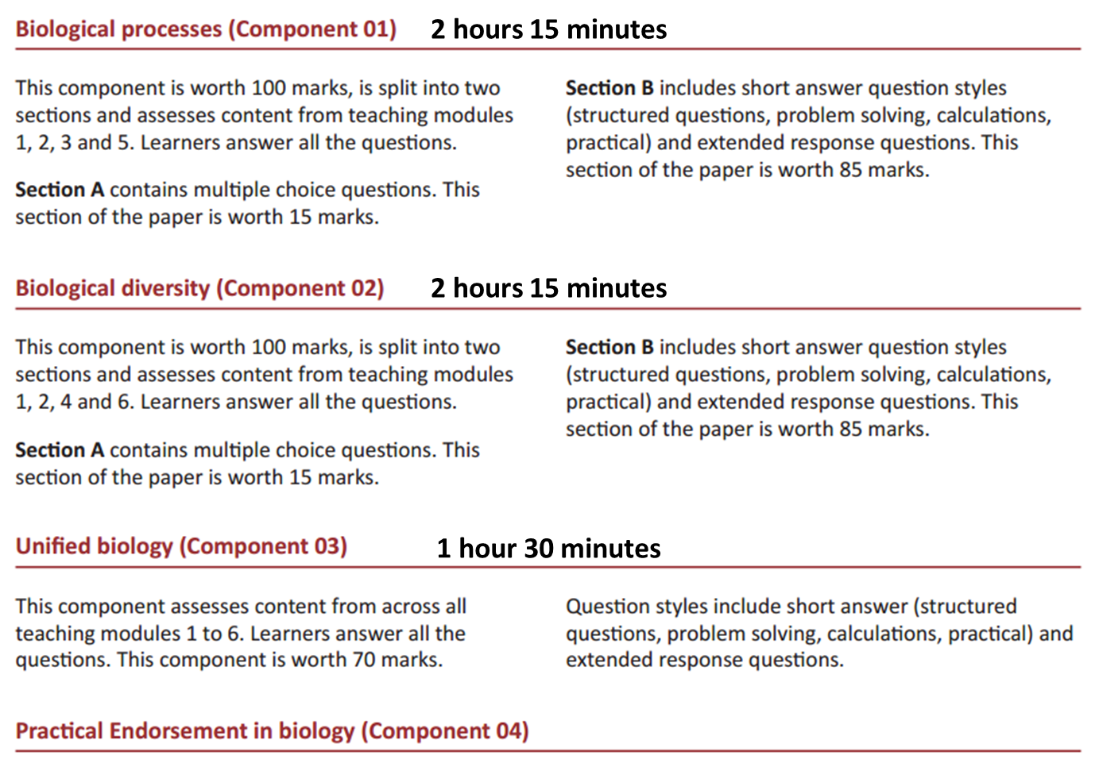
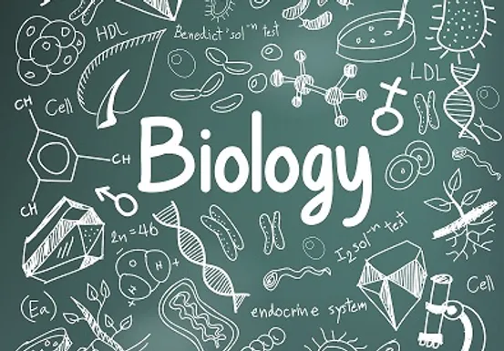
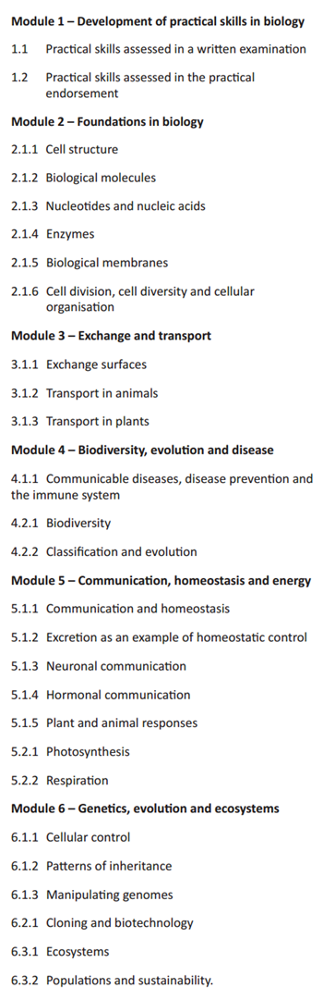

OCR Biology A (H420)
Useful resources:
Specification and lots more useful stuff here - ocr.org.uk/alevelbiologya
Online textbook at Kerboodle.com
Wednesday lunchtimes – revision and exam technique
The Learning scientists – two scientists that have devoted their careers to studying evidence-based revision techniques: https://www.learningscientists.org
SenecaLearning.com – active revision site
SaveMyExams – revision notes and past paper questions
PhysicsAndMathsTutor – revision notes and past paper questions

