Slide 1

R.M.S. – “Root Mean Square”
A mathematical trick to help our calculations behave like the real world
Consider the molecules in a gas
They’re all moving in different directions, randomly.
So their average velocity is zero.
Even if we heat the gas so they move faster,
the average velocity is still zero.

Slide 2
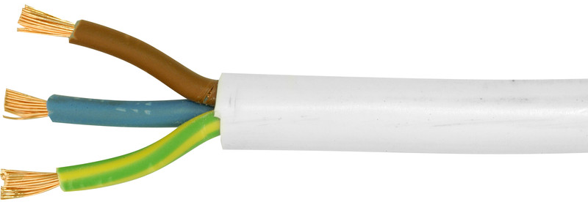
Consider the live wire in a UK mains flex.
The a.c. voltage is going up and down, positive & negative, 50 times each second.
So the average voltage is zero.
So if you grab hold of that live wire, you’ll be fine, right?
We need a way to deal with these situations that doesn’t give us a zero result.
It’s called a “root mean square”

Slide 3
The a.c. mains example is the easiest one to learn about first.
Here’s the waveform

Slide 4
First, we square it.
Now it’s all positive

Slide 5
First, we square it.
Now it’s all positive
THEN we
take the mean →

Slide 6
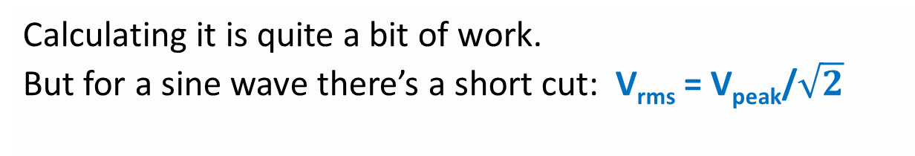
The green line is the Root of the Mean of the SQUARE
of the original waveform
Then we take the square root →
Calculating it is quite a bit of work.
But for a sine wave there’s a short cut: V_{rms} = V_{peak}/$\sqrt{2}$
Or V_{rms} = 0.7071 x V_{peak}
An a.c. voltmeter gives you the rms voltage, not the peak.
That’s handy – because the power transferred e.g. in a heater is calculated using the rms voltage
What you’ve believed to be 230V a.c UK mains is actually 325V peak voltage

